Slide 1
Financial Analytics

Slide 2
Objective:
Without analyzing the competition, it is difficult for a business to survive. You are tasked to analyzing the competition for the management to provide better results. This data set has information on the market capitalization of the top 500 companies in India. Serial NumberNameName of CompanyMar Cap – CroreMarket Capitalization in CroresSales Qtr – CroreQuarterly Sale in crores Find key metrics and factors and show the meaningful relationships between attributes
Benefits:
Informed Decision Making
Generating Sales Estimates
Staying Competitive
Optimized Cash Flow
Better Security

Slide 3
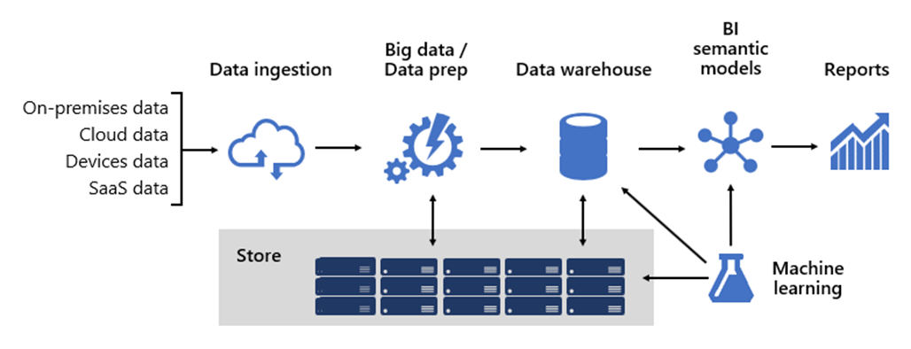
Architecture

Slide 4
Data Validation :
To begin, a sample of data is determined. This is useful when the data set is massive, because it is easier to validate a part rather than the whole set. The volume of the sample needs to be in accordance with the size of the data set and an acceptable error rate must be defined before the process is initiated.
Next, the dataset needs to be validated to confirm it contains all the required data.
Finally, the source data’s value, structure, format etc. is matched with the schema of the destination. The data is checked for redundant, incomplete, inconsistent, or incorrect values as well.
Data Transformation –
Constructive, where data is added, copied or replicated
Destructive, where records and fields are deleted
Aesthetic, where certain values are standardized, or
Structural, which includes columns being renamed, moved and combined

Slide 5
Data Preprocessing
Performing EDA to get insight of data like identifying distribution , outliers ,trend
among data etc.
Check for null values in the columns. If present impute the null values.

